Slide 1
EECE 571F: Deep Learning with Structures
Lecture 5: Group Equivariant Deep Learning
Renjie Liao
University of British Columbia
Winter, Term 1, 2023

Slide 2
Course Scope
Brief Intro to Deep Learning
Geometric Deep Learning
  Deep Learning Models for Sets and Sequences: Deep Sets & Transformers
  Deep Learning Models for Graphs: Message Passing & Graph Convolution GNNs
  Group Equivariant Deep Learning
Probabilistic Deep Learning
  Auto-regressive models, Large Language Models (LLMs)
  Variational Auto-Encoders (VAEs) and Generative Adversarial Networks (GANs)
  Energy based models (EBMs)
  Diffusion/Score based models

Slide 3
Course Scope
Brief Intro to Deep Learning
Geometric Deep Learning
  Deep Learning Models for Sets and Sequences: Deep Sets & Transformers
  Deep Learning Models for Graphs: Message Passing & Graph Convolution GNNs
  Group Equivariant Deep Learning
Probabilistic Deep Learning
  Auto-regressive models, Large Language Models (LLMs)
  Variational Auto-Encoders (VAEs) and Generative Adversarial Networks (GANs)
  Energy based models (EBMs)
  Diffusion/Score based models

Slide 4
Why Groups?
Symmetries are everywhere in nature!

Slide 5
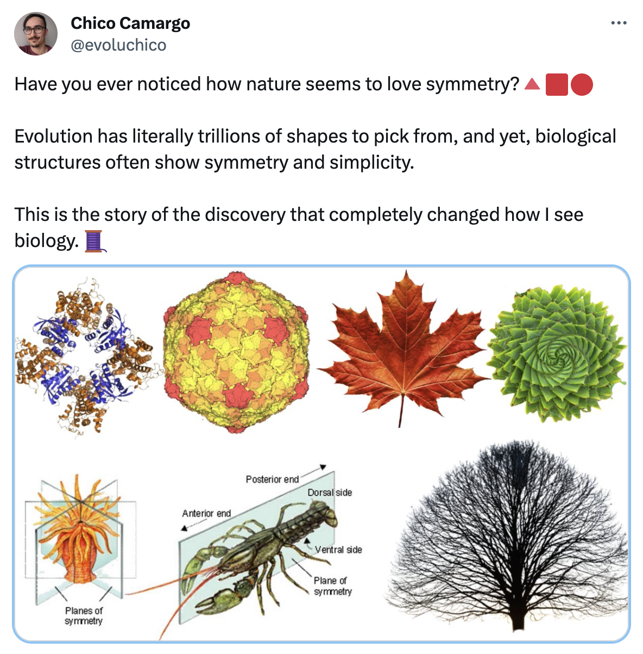
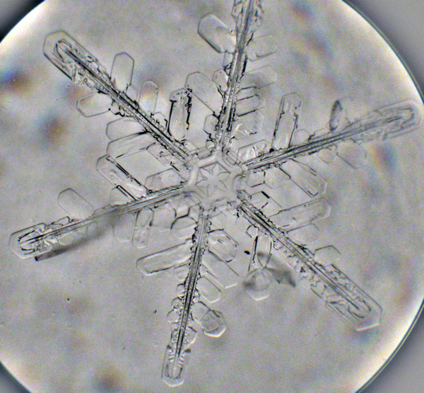
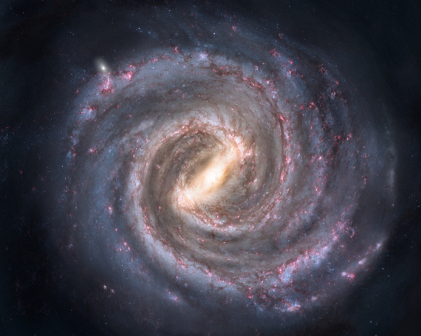
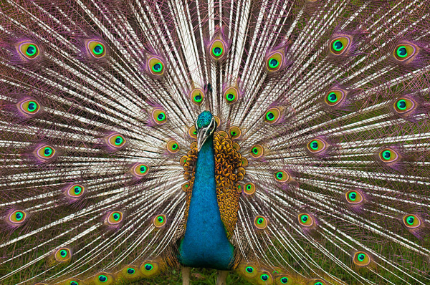

Why Groups?
Symmetries are everywhere in nature!
Image Credit: [1] & X user “evoluchico”

Slide 6
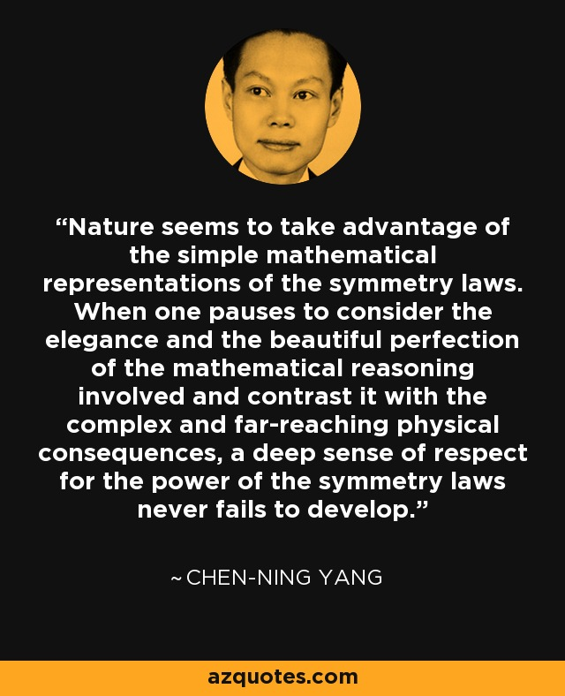
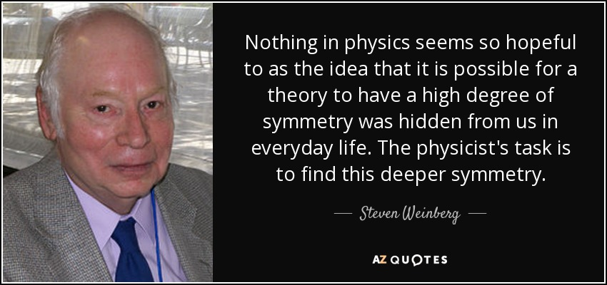
Why Groups?
Symmetries are everywhere in nature!
Image Credit: [2]

Slide 7
Why Groups?
Symmetries are everywhere in nature!
Group theory is the mathematical study of symmetry!
Image Credit: [2]

Slide 8
Why Groups?
Symmetries are everywhere in nature!
Group theory is the mathematical study of symmetry!
From deep learning perspective, it could enable:
  Better architectures, e.g., guaranteed invariance or equivariance w.r.t. certain symmetries

Slide 9
Why Groups?
Symmetries are everywhere in nature!
Group theory is the mathematical study of symmetry!
From deep learning perspective, it could enable:
  Better architectures, e.g., guaranteed invariance or equivariance w.r.t. certain symmetries
  Efficient/compact representation learning, e.g., lower sample complexities

Slide 10
What is a Group?
A group is an algebraic structure that consists of a set and a binary operator · called the group product, that satisfies the following axioms:
Closure:
Identity:
Inverse:
Associativity:
Notes:
\forall h, g \in G, h \cdot g \in G
\exists e \in G, \forall g \in G, e \cdot g = g \cdot e = g
\forall g \in G, \exists g^{-1} \in G, g^{-1} \cdot g = g \cdot g^{-1} = e
\forall g, h, f \in G, (g \cdot h) \cdot f = g \cdot (h \cdot f)

Slide 11
What is a Group?
A group is an algebraic structure that consists of a set and a binary operator · called the group product, that satisfies the following axioms:
Closure:
Identity:
Inverse:
Associativity:
Notes:
\forall h, g \in G, h \cdot g \in G
\exists e \in G, \forall g \in G, e \cdot g = g \cdot e = g
\forall g \in G, \exists g^{-1} \in G, g^{-1} \cdot g = g \cdot g^{-1} = e
\forall g, h, f \in G, (g \cdot h) \cdot f = g \cdot (h \cdot f)

Slide 12
What is a Group?
A group is an algebraic structure that consists of a set and a binary operator · called the group product, that satisfies the following axioms:
Closure:
Identity:
Inverse:
Associativity:
Notes:
\forall h, g \in G, h \cdot g \in G
\exists e \in G, \forall g \in G, e \cdot g = g \cdot e = g
\forall g \in G, \exists g^{-1} \in G, g^{-1} \cdot g = g \cdot g^{-1} = e
\forall g, h, f \in G, (g \cdot h) \cdot f = g \cdot (h \cdot f)

Slide 13
What is a Group?
A group is an algebraic structure that consists of a set and a binary operator · called the group product, that satisfies the following axioms:
Closure:
Identity:
Inverse:
Associativity:
Notes:
\forall h, g \in G, h \cdot g \in G
\exists e \in G, \forall g \in G, e \cdot g = g \cdot e = g
\forall g \in G, \exists g^{-1} \in G, g^{-1} \cdot g = g \cdot g^{-1} = e
\forall g, h, f \in G, (g \cdot h) \cdot f = g \cdot (h \cdot f)

Slide 14
What is a Group?
A group is an algebraic structure that consists of a set and a binary operator · called the group product, that satisfies the following axioms:
Closure:
Identity:
Inverse:
Associativity:
Notes:
\forall h, g \in G, h \cdot g \in G
\exists e \in G, \forall g \in G, e \cdot g = g \cdot e = g
\forall g \in G, \exists g^{-1} \in G, g^{-1} \cdot g = g \cdot g^{-1} = e
\forall g, h, f \in G, (g \cdot h) \cdot f = g \cdot (h \cdot f)

Slide 15
What is a Group?
A group is an algebraic structure that consists of a set and a binary operator · called the group product, that satisfies the following axioms:
Closure:
Identity:
Inverse:
Associativity:
We denote the group as
Notes:
\forall h, g \in G, h \cdot g \in G
\exists e \in G, \forall g \in G, e \cdot g = g \cdot e = g
\forall g \in G, \exists g^{-1} \in G, g^{-1} \cdot g = g \cdot g^{-1} = e
\forall g, h, f \in G, (g \cdot h) \cdot f = g \cdot (h \cdot f)

Slide 16
Examples
  2D Translation Group
  It consists of all possible translations in equipped with addition
Notes:
(\mathbb{R}^2, +)

Slide 17
Examples
  2D Translation Group
  It consists of all possible translations in equipped with addition
  Suppose
Closure:
Identity:
Inverse:
Associativity:
Notes:
(\mathbb{R}^2, +)
\mathbf{x} = \mathbf{0}
g = (\mathbf{x}), g^{\prime} = (\mathbf{x}^{\prime}), \mathbf{x}, \mathbf{x}^{\prime} \in \mathbb{R}^2
g^{-1} = (-\mathbf{x})

Slide 18
Examples
  2D Translation Group
  It consists of all possible translations in equipped with addition
  Suppose
✓
Closure:
Identity:
Inverse:
Associativity:
Notes:
(\mathbb{R}^2, +)
\mathbf{x} = \mathbf{0}
g = (\mathbf{x}), g^{\prime} = (\mathbf{x}^{\prime}), \mathbf{x}, \mathbf{x}^{\prime} \in \mathbb{R}^2
g^{-1} = (-\mathbf{x})
g \cdot g^{\prime} = (\mathbf{x} + \mathbf{x}^{\prime})

Slide 19
Examples
  2D Translation Group
  It consists of all possible translations in equipped with addition
  Suppose
✓
Closure:
Identity:
Inverse:
Associativity:
✓
Notes:
(\mathbb{R}^2, +)
\mathbf{x} = \mathbf{0}
g = (\mathbf{x}), g^{\prime} = (\mathbf{x}^{\prime}), \mathbf{x}, \mathbf{x}^{\prime} \in \mathbb{R}^2
g^{-1} = (-\mathbf{x})
g \cdot g^{\prime} = (\mathbf{x} + \mathbf{x}^{\prime})

Slide 20
Examples
  2D Translation Group
  It consists of all possible translations in equipped with addition
  Suppose
✓
Closure:
Identity:
Inverse:
Associativity:
✓
✓
Notes:
(\mathbb{R}^2, +)
\mathbf{x} = \mathbf{0}
g = (\mathbf{x}), g^{\prime} = (\mathbf{x}^{\prime}), \mathbf{x}, \mathbf{x}^{\prime} \in \mathbb{R}^2
g^{-1} = (-\mathbf{x})
g \cdot g^{\prime} = (\mathbf{x} + \mathbf{x}^{\prime})

Slide 21
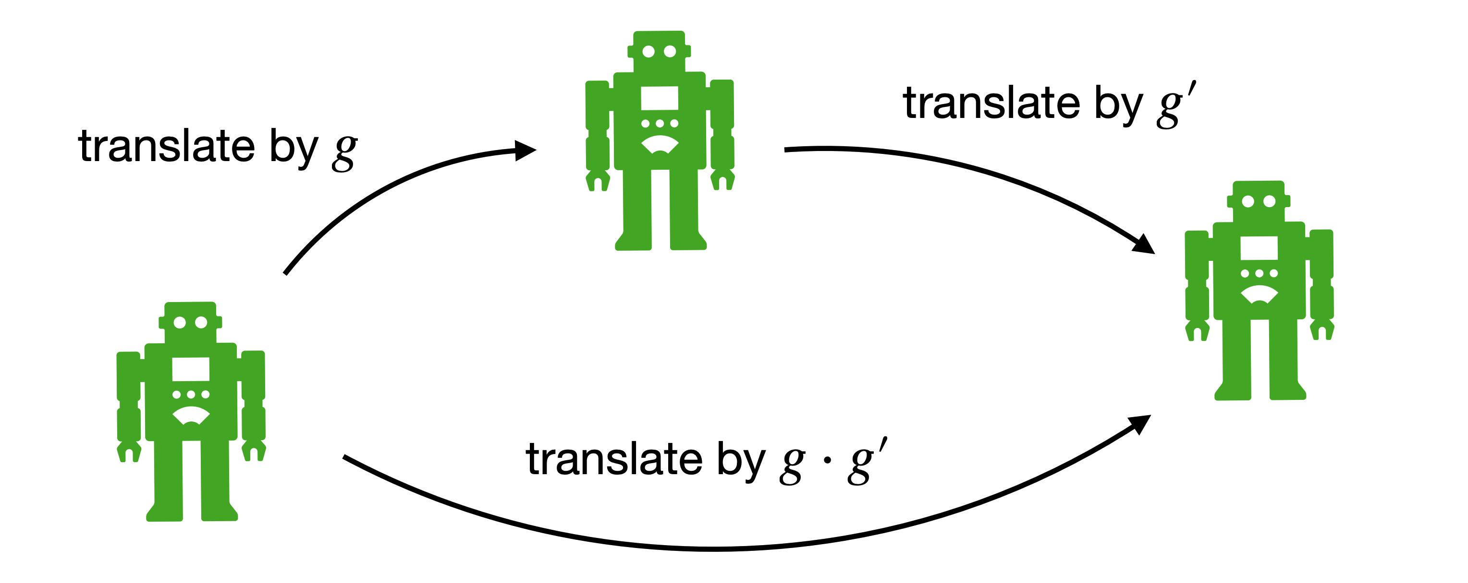
Examples
  2D Translation Group
  It consists of all possible translations in equipped with addition
  Suppose
✓
Closure:
Identity:
Inverse:
Associativity:
✓
✓
✓
Image Credit: [3]
Notes:
(\mathbb{R}^2, +)
\mathbf{x} = \mathbf{0}
g = (\mathbf{x}), g^{\prime} = (\mathbf{x}^{\prime}), \mathbf{x}, \mathbf{x}^{\prime} \in \mathbb{R}^2
g^{-1} = (-\mathbf{x})
g \cdot g^{\prime} = (\mathbf{x} + \mathbf{x}^{\prime})

Slide 22
Examples
  2D Rotation Group
  It consists of all possible rotations in equipped with addition
  Recap on 2D rotation
Notes:
\text{SO}(2) = \left(\{Q \in \text{GL}(2, \mathbb{R}) \vert QQ^{\top} = Q^{\top}Q = I, \det{(Q)} = 1 \}, \cdot\right)

Slide 23
Examples
  2D Translation Group
  It consists of all possible translations in equipped with addition
  Suppose
Closure:
Identity:
Inverse:
Associativity:
Notes:
(\mathbb{R}^2, +)
\mathbf{x} = \mathbf{0}
g = (\mathbf{x}), g^{\prime} = (\mathbf{x}^{\prime}), \mathbf{x}, \mathbf{x}^{\prime} \in \mathbb{R}^2
g^{-1} = (-\mathbf{x})

Slide 24
Examples
  2D Translation Group
  It consists of all possible translations in equipped with addition
  Suppose
✓
Closure:
Identity:
Inverse:
Associativity:
Notes:
(\mathbb{R}^2, +)
\mathbf{x} = \mathbf{0}
g = (\mathbf{x}), g^{\prime} = (\mathbf{x}^{\prime}), \mathbf{x}, \mathbf{x}^{\prime} \in \mathbb{R}^2
g^{-1} = (-\mathbf{x})

Slide 25
Examples
  2D Translation Group
  It consists of all possible translations in equipped with addition
  Suppose
✓
Closure:
Identity:
Inverse:
Associativity:
✓
Notes:
(\mathbb{R}^2, +)
\mathbf{x} = \mathbf{0}
g = (\mathbf{x}), g^{\prime} = (\mathbf{x}^{\prime}), \mathbf{x}, \mathbf{x}^{\prime} \in \mathbb{R}^2
g^{-1} = (-\mathbf{x})

Slide 26
Examples
  2D Translation Group
  It consists of all possible translations in equipped with addition
  Suppose
✓
Closure:
Identity:
Inverse:
Associativity:
✓
✓
Notes:
(\mathbb{R}^2, +)
\mathbf{x} = \mathbf{0}
g = (\mathbf{x}), g^{\prime} = (\mathbf{x}^{\prime}), \mathbf{x}, \mathbf{x}^{\prime} \in \mathbb{R}^2
g^{-1} = (-\mathbf{x})

Slide 27
Examples
  2D Translation Group
  It consists of all possible translations in equipped with addition
  Suppose
✓
Closure:
Identity:
Inverse:
Associativity:
✓
✓
✓
Image Credit: [3]
Notes:
(\mathbb{R}^2, +)
\mathbf{x} = \mathbf{0}
g = (\mathbf{x}), g^{\prime} = (\mathbf{x}^{\prime}), \mathbf{x}, \mathbf{x}^{\prime} \in \mathbb{R}^2
g^{-1} = (-\mathbf{x})

Slide 28
Examples
  2D Translation Group
  It consists of all possible translations in equipped with addition
Image Credit: [3]
Notes:
(\mathbb{R}^2, +)

Slide 29
References
[1] https://listverse.com/2013/04/21/10-beautiful-examples-of-symmetry-in-nature/
[2] https://www.azquotes.com/
[3] UvA Course by Erik Bekkers: An Introduction to Group Equivariant Deep Learning: https://uvagedl.github.io/
[4]

Slide 30
Questions?

